Slide 1
Using CSS In HTML
Introduction to CSS | CSS Rules | Ways to Apply CSS to HTML | Inheritance and Conflict
Notes:
Welcome to our lecture on CSS. In this lecture we will go through the introduction to css, css rules, how to apply css to html, and inheritance and conflicts in css. Let’s start the lecture.

Slide 2
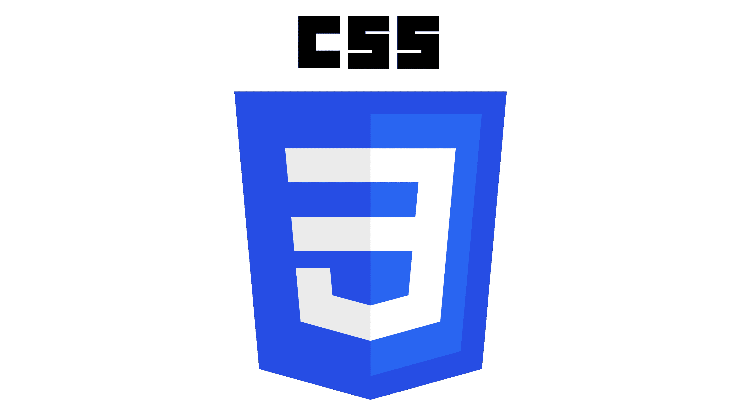
Introduction to CSS
CSS: Cascading Style Sheets define the styling of a webpage.
Purpose: Determines how content is visually presented across media.
Usage: Used by browsers to render webpages on screens, print, or other formats.
Notes:
The CSS, or Cascading Style Sheets, defines the styling of a webpage, determining how content is visually presented across various media. Browsers use CSS to render webpages on screens, in print, or in other formats. By separating style from structure, CSS enhances design flexibility and ensures consistent visual presentation across different devices and platforms.

Slide 3
CSS Rules
CSS Rules: Consists of a selector and a declaration block in braces.
Selector: Specifies the HTML element(s) to style.
Declaration Block: Contains declarations separated by semicolons.
Declaration: Includes a property (reserved word) and its value separated by a colon.
Property: Reserved word or words with dashes. Defines specific element styles or attributes.
Notes:
CSS can be applied using some rules. CSS rules define how elements are styled, consisting of a selector and a declaration block within braces. The selector targets specific HTML elements, while the declaration block contains declarations separated by semicolons. Each declaration pairs a property, which defines a style or attribute, with a value. Properties are reserved words, often separated by dashes, specifying element styles.

Slide 4
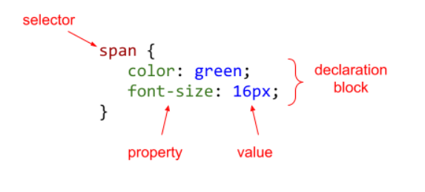
CSS Rules Example
Notes:
This example shows a CSS rule with a selector, declaration block, properties, and values. The selector span targets all span elements. The declaration block contains multiple declarations, such as color set to green and font-size set to 16px. Each declaration pairs a property, like color or font size, with a value, defining how the targeted elements are styled on the webpage.

Slide 5
Ways of Applying CSS to HTML
CSS can be applied to HTML in three ways:
An inline style places CSS declarations inside an element's style attribute.
An embedded stylesheet places CSS rules in an HTML document's head using a <style> element.
An external stylesheet places CSS rules in a separate file that is imported into an HTML document with a <link> element.
Notes:
CSS can be applied to HTML in three ways. Inline styles use the style attribute inside an element to apply CSS declarations. Embedded stylesheets place CSS rules within a style element in the head of the HTML document. External stylesheets store CSS rules in a separate file, which is linked to the HTML document using a link element. Each method serves different purposes for organizing and applying styles.

Slide 6
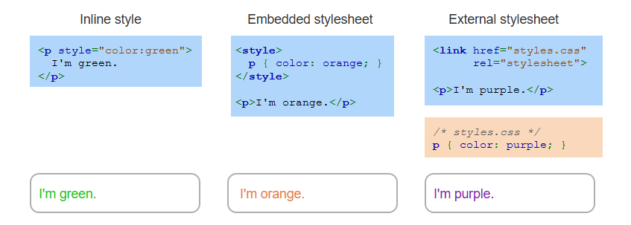
Example
Notes:
This example shows three ways to apply CSS to HTML. Inline styles are added directly to an element using the style attribute. Embedded stylesheets use the style element in the head section to apply rules to multiple elements. External stylesheets link a separate CSS file using the link element, allowing for consistent styling across multiple HTML documents. Each method provides unique benefits for styling.

Slide 7
Inheritance and Conflict
Default Styles: Browsers have default styles for HTML elements, overridden by CSS.
Inheritance: Styles cascade from parent to child elements unless explicitly overridden.
Parent vs. Child: Child styles override conflicting parent styles.
Inline vs. Stylesheet: Inline styles override embedded or external styles in conflicts.
Notes:
Now move to inheritance and conflicts in CSS. Browsers apply default styles to HTML elements, but CSS rules override these defaults. Styles cascade from parent to child elements unless explicitly overridden. When a parent and child have conflicting styles, the child styles take priority. In conflicts between inline and external or embedded styles, inline styles override the others, ensuring specific styling for elements.

Slide 8
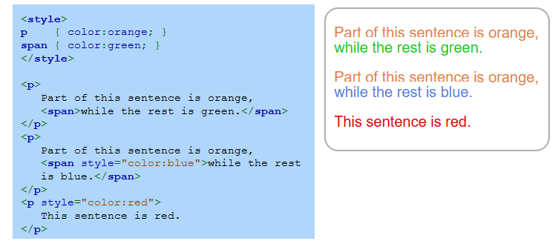
Example
Notes:
This example demonstrates CSS inheritance and style overriding. Paragraphs have a default orange color set by the p selector. The span selector applies green to spans within paragraphs. Inline styles override these, as shown with the blue span and the fully red paragraph. This highlights how inline styles take precedence over external or embedded styles, enabling precise element customization.

Slide 9
Specificity and !important
Specificity: A scoring system to resolve CSS conflicts.
!important Rule: Overrides other declarations, ignoring specificity.
Best Practice: Avoid using !important for easier maintenance.
Notes:
Now move to another concept specificity and not important. CSS specificity is a scoring system used to resolve conflicts between style rules. The not important rule can override other declarations, ignoring specificity, and ensures the applied style takes precedence. However, using not important is not recommended, as it can make styles harder to understand and maintain. Best practice is to rely on proper CSS structure and specificity instead of not important.

Slide 10
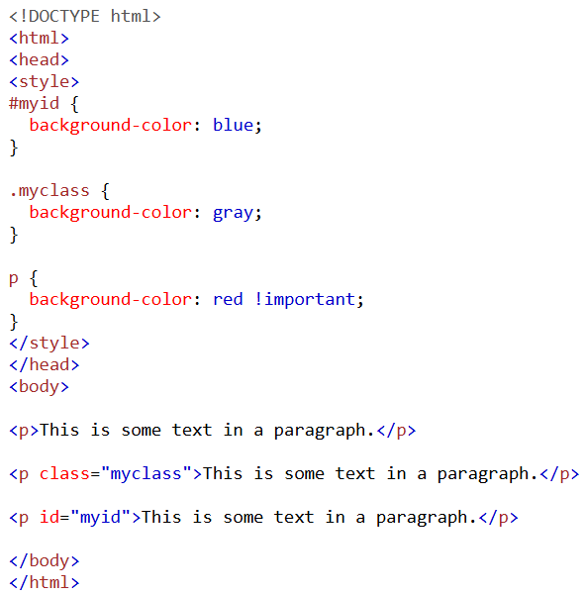
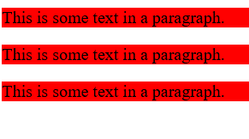
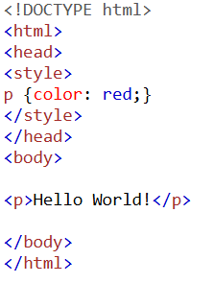
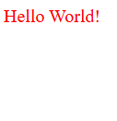
Specificity vs !important Example
Notes:
This example compares specificity and the not important rule. The left image shows code without not important, styles are applied based on specificity. The right image shows an id selector my id takes precedence over a class selector my class, which in turn overrides a general element selector p. However, the not important rule, as seen with p, overrides all, regardless of specificity. While powerful, using not important is discouraged for maintainability.

Slide 11
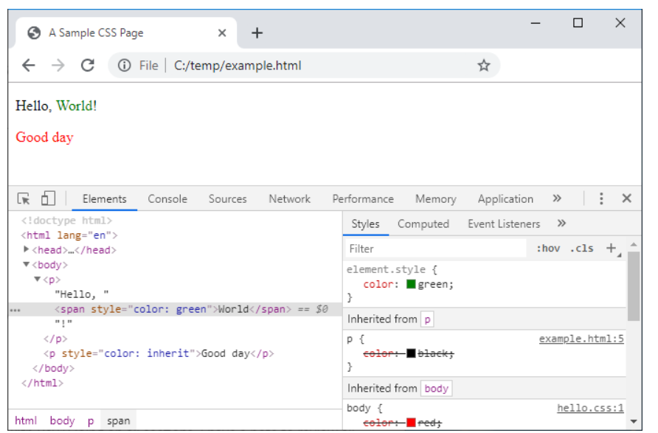
View CSS Using Chrome Dev Tool
Notes:
Chrome Dev Tools displays the CSS rules applied to webpage elements. Inline styles, such as span with color set to green, override parent styles like p or body element declarations. This example highlights the cascade and priority of inline styles over inherited styles, showcasing how Dev Tools helps debug and understand CSS rules and inheritance in web development. Thanks for watching the lecture.

